Slide 1
K8C
Resources and microservices

Slide 2
Product description
The product is a platform for deploying, managing, and scaling machine learning models in production. It offers a secure, flexible environment for automating ML tasks like model versioning, routing, and monitoring. With Kubernetes integration and containerization support, it's designed for developers, ML engineers, and enterprises needing scalable, reliable ML infrastructure.
Team K8C: Tsurkan Daniel; Dandamaev Gadji; Tsaturyan Konstantin; Smolkin Mikhail
Project repo: https://github.com/fanglores/Advanced-Software-Design
This report: https://github.com/fanglores/Advanced-Software-Design /blob/master/Practice%20Tasks/Module2/Task9/

Slide 3
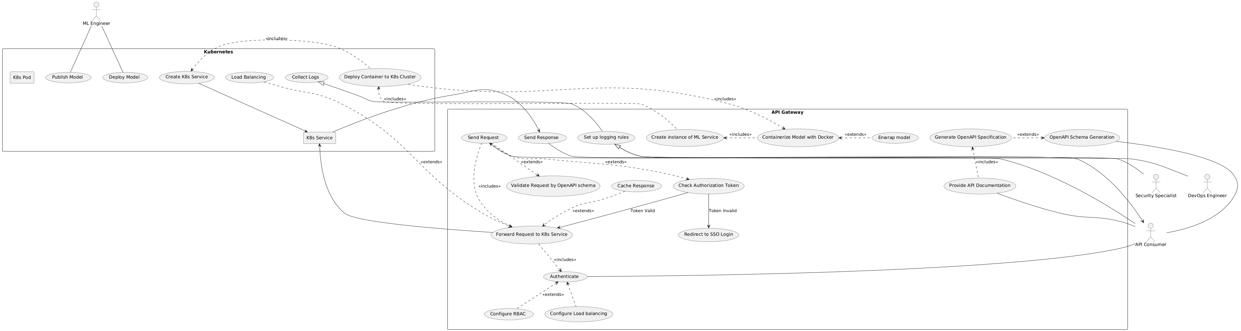
Use case diagram
https://github.com/fanglores/Advanced-Software-Design/tree/master/General/UseCases

Slide 4
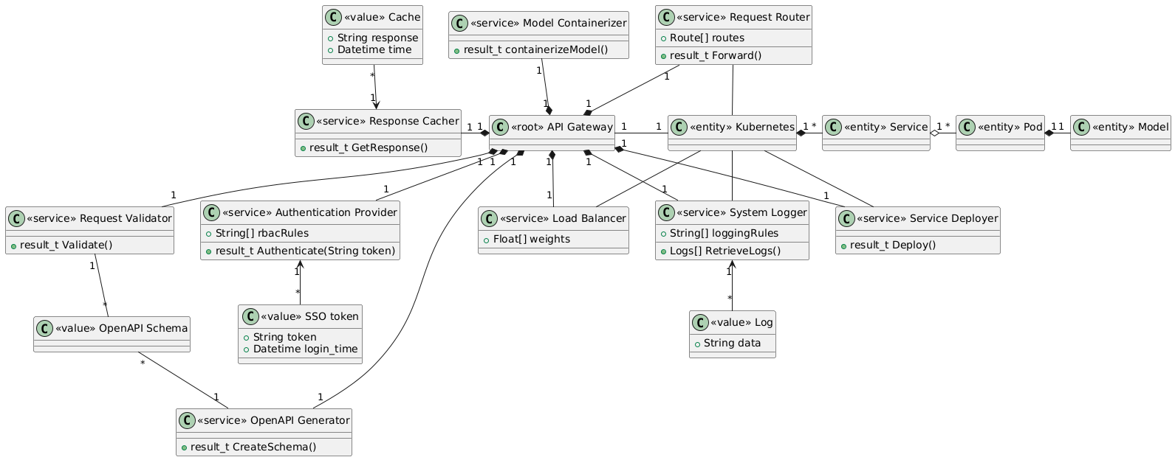
Final class diagram (monolith)

Slide 5
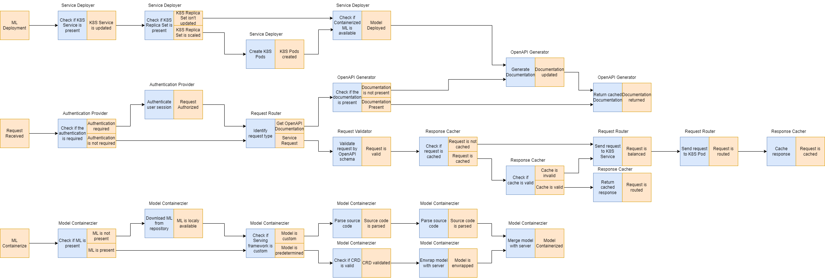
Event storming

Slide 6
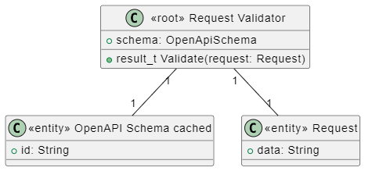
Request Validator Aggregation

Slide 7
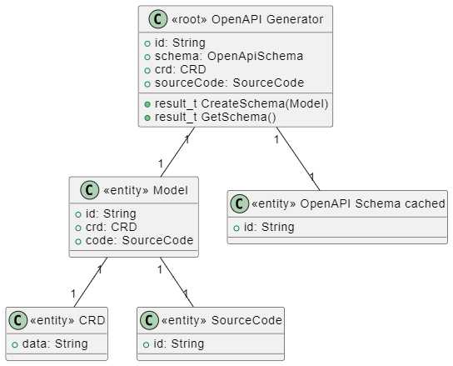
OpenAPI Generator Aggregation

Slide 8
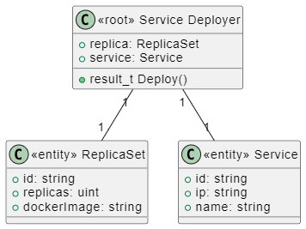
Service Deployer Aggregation

Slide 9
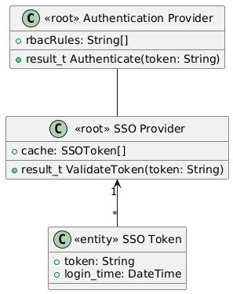
Authentication Provider Aggregation

